Slide 1
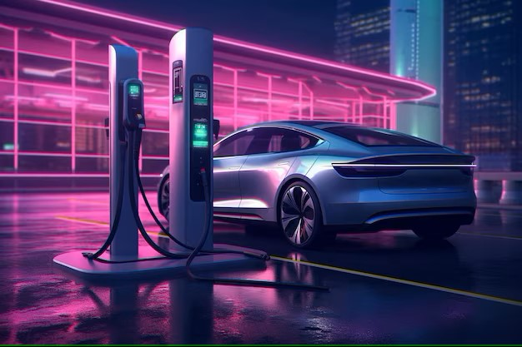
CHARGING STATION INSTALLATION
Presented By:
Shiv Prakash Verma (2021EEB1030)
Varun Sharma (2021EEB1032)
Akshit Pal (2021EEB1150)
Anmol Yadav (2021EEB1153)
Harshal Sandhu (2021EEB1174)

Slide 2

INDEX
Objective
Motivation
Abstract
Methodology
4.A Methodology Overview
4.B Location Point Validation
4.C Optimization-decision variables and objective functions
4.D Optimization-algorithm
Expected Results
Further Explorations

Slide 3

1. OBJECTIVE
To develop a data-driven and optimization-based approach to identify the optimal placement locations for electric vehicle (EV) charging stations within a specific geographic region.
Specific goals:
Optimize station placement
Maximize accessibility
Increase utilization
Promote network efficiency

Slide 4

2. MOTIVATION
Our world is rapidly transitioning to electric vehicles (EVs). To ensure a smooth and convenient adoption, a strategically planned network of charging stations is crucial. This project tackles the critical issue of charging station placement. By carefully analyzing factors like operating and installation cost, accessibility, EV density in a region, demographics, and existing infrastructure, we aim to identify optimal locations for charging stations. This will not only enhance the user experience for EV drivers but also accelerate the widespread adoption of electric vehicles, contributing to a cleaner and more sustainable future.

Slide 5
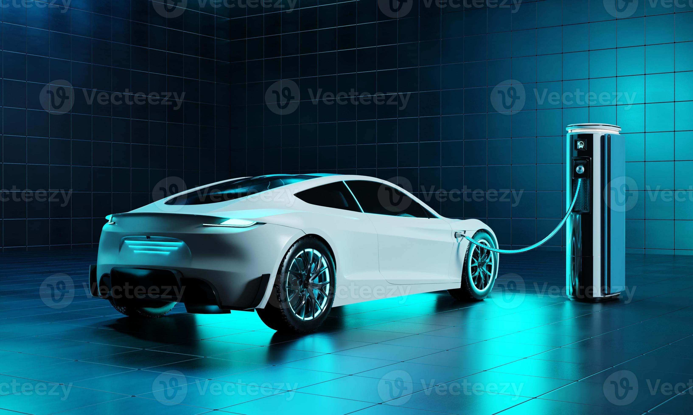
3. ABSTRACT
As India's population surges and environmental concerns mount, electric vehicles (EVs) are becoming the clear path towards sustainable transportation. A planned city in India is witnessing a boom in EVs, but widespread adoption hinges on a well-developed charging infrastructure. This project tackles this challenge by optimizing charging station placement within this planned city. We'll consider a multifaceted approach, accounting for economic viability, power grid stability (including voltage stability, reliability, and power loss), user convenience, and real-world traffic patterns. By employing a hybrid optimization algorithm that combines Chicken Swarm Optimization (CSO) and Teaching-Learning Based Optimization (TLBO), we'll identify ideal locations for charging stations. Finally, we'll utilize fuzzy decision-making to compare these optimal solutions and ensure the chosen plan fosters widespread EV adoption in the planned city.

Slide 6
4. METHODOLOGY
4.A Overview

Slide 7
4. METHODOLOGY
4.B Location Point Validation

Slide 8
4. METHODOLOGY
4.C Optimization-Decision variables and objective function

Slide 9
4. METHODOLOGY
4.C Optimization-Algorithm

Slide 10
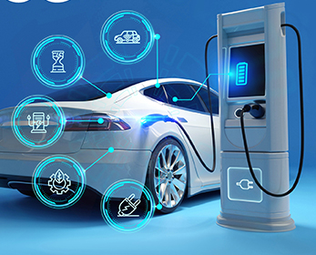
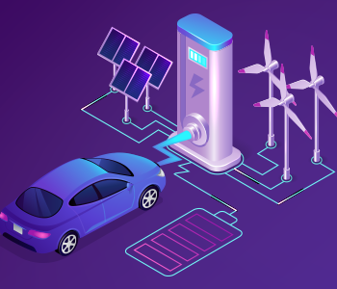

5. EXPECTED RESULTS

Slide 11

6. FURTHER EXPLORATIONS

